Slide 1

Advanced Data Mining and Predictive Analytics-Loan Prediction
Group-5 Niharika Matsa Durga Prasad Gandi Deekshitha Sai Sangepu James Guy

Slide 2
Agenda
1
2
3
4
5
Project Goal
Overview of the Data
Model selection and Implementation
Model Performance
Conclusion

Slide 3

ABSTRACT
This study employs predictive analytics to forecast loan defaults and assess financial losses in the banking sector. Utilizing historical data and advanced techniques like Principal Component Analysis (PCA) and Random Forest models, it aids in risk management by offering insights into default likelihood and loss severity, enhancing decision-making processes.

Slide 4
Project Goal
Our objective is to develop a precise machine learning model using preprocessed data to forecast loan repayment and discern default factors, thus fortifying risk management in lending for optimized returns.

Slide 5

Methodologies:
A meticulous data preprocessing phase was conducted to ensure the integrity and quality of the dataset. This involved handling missing values, cleaning the data, and eliminating variables with zero variance.

Slide 6
Data Overview
We utilized two datasets: Training Data with 80,000 observations and Test Data with 25,471 rows, both featuring common attributes such as unique customer IDs and factors influencing loan repayment.
Objective: Develop a model to predict loan default risk using training data and apply it to test data.

Slide 7
Data Analysis
The exploratory analysis involves examining data characteristics and potential issues, including descriptive statistics, handling missing values, and eliminating zero-variance variables.

Slide 8
Key steps in the data analysis included
Identifying and handling missing values
Eliminating variables with zero variance
Descriptive Statistics
Modelling Strategies
Model Selection

Slide 9
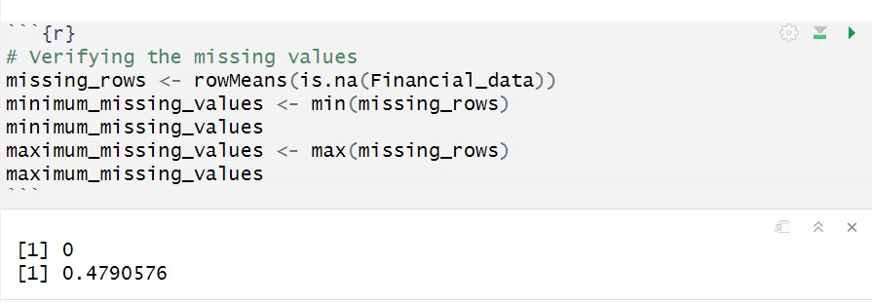
Identifying and handling missing values
Cleaning and preprocessing data:
The depiction is shown below.

Slide 10
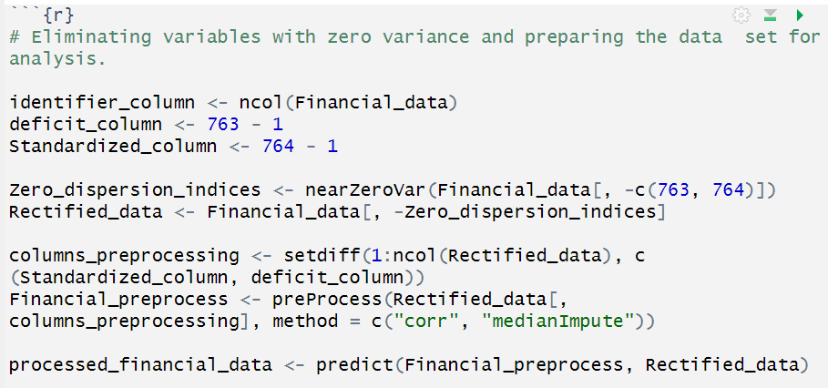
Eliminating variables with zero variance
One of the initial steps in this process involved removing zero-variance variables from the dataset.

Slide 11
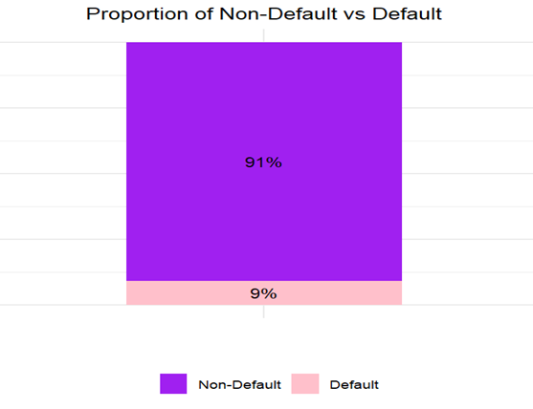
Descriptive Statistics
These descriptive statistics provide a comprehensive overview of the dataset's characteristics, enabling us to understand its distribution, variability, and potential data quality issues before proceeding with further analysis

Slide 12
The project employed four distinct models:
1. Lasso Regression for variable selection and dimensionality reduction.
2. Principal Component Analysis (PCA) for further dimensionality reduction and feature extraction.

Slide 13
3. Random Forest for classification tasks, particularly effective for handling imbalanced data. 4.Ridge Regression for quantifying financial losses and addressing multicollinearity among features.

Slide 14
Model Development
During model development, Lasso regression was employed to trim attributes from 248 to 175, streamlining model complexity. Subsequently, PCA further condensed dimensionality to 69 key components. Finally, Random Forest facilitated classification, while Ridge Regression quantified financial losses.

Slide 15
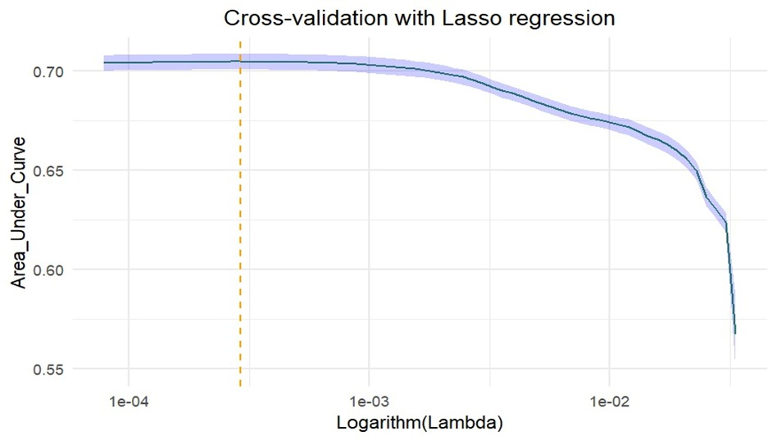
Insights: Lasso Regression (Variable Selection)
The AUC curve exhibits a characteristic shape, initially increasing as the lambda value decreases, reaching a peak, and then declining as lambda continues to decrease further. This behavior has important implications for model performance and complexity.

Slide 16
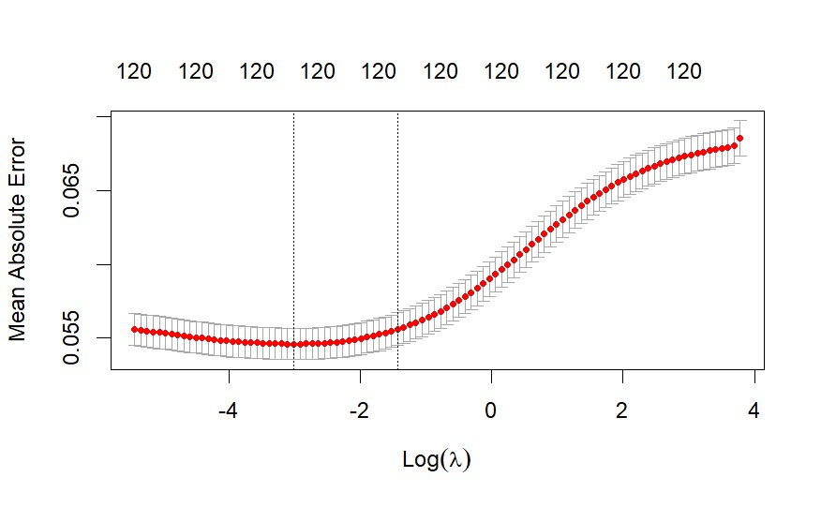
Mean Absolute Error
The minimum point of the error curve corresponds to the optimal lambda value for ridge regression. Based on the graph, the optimal lambda value appears to be around log(λ) = 0, as indicated by the lowest point of the curve.

Slide 17
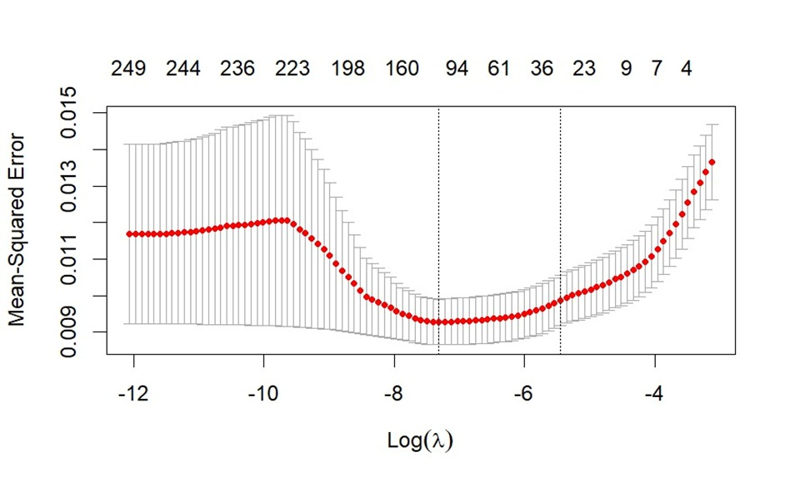
Mean Square Error
The minimum point of the MSE curve corresponds to the optimal lambda value, which strikes the best balance between model complexity and predictive performance. Based on the graph, the optimal lambda value appears to be around log(λ) = -6 or -7, as indicated by the lowest point of the MSE curve.

Slide 18
Performance metrics
The model's performance metrics indicate strong performance:
Accuracy: 90.25%
95% Confidence Interval
Mean Square Error: 0.0006662975
Mean Absolute Error (MAE): 0.04916647

Slide 19
Future Enhancements:
Random Forest was super helpful in our analysis for two main reasons.
It handled imbalanced data really well, so we got solid predictions for both loan defaults and non-defaults.
It's like having a bunch of smart detectives working together - it found hidden patterns in our data, making our predictions much more accurate.

Slide 20
Conclusion:
The model effectively predicts loan defaults and estimates associated losses, achieving high accuracy without signs of overfitting. Overall, the project successfully meets its goal of accurate prediction of loan defaults and associated financial losses.

Slide 21
Thank you

